Slide 1

50 BEDED UPAZILA HEALTH COMPLEX
Chowgacha, Jessore.

Slide 2

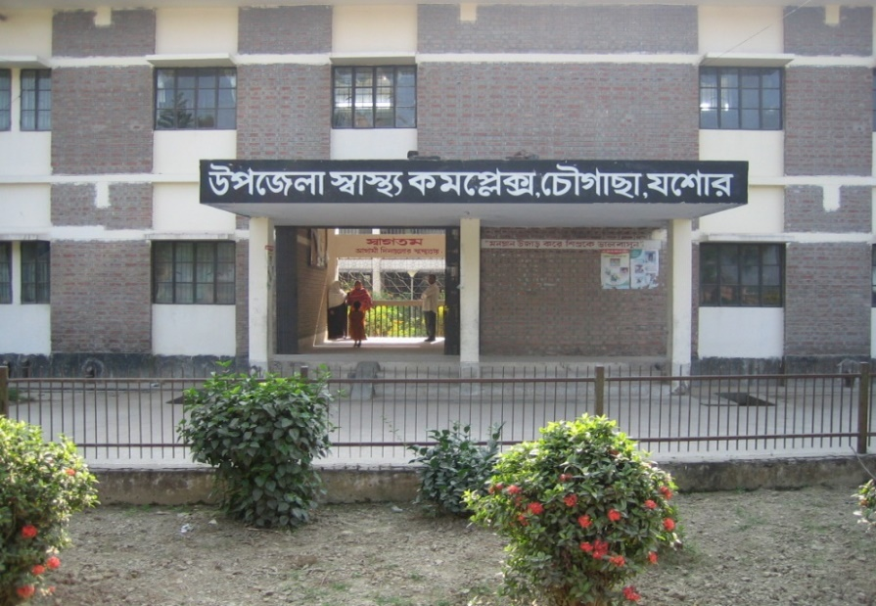


CHOWGACHA UHC
Old UHC
31 beded UHC
50 beded UHC

Slide 3
A Hospital with a Vision …
Maximum utilization of Govt.
resources with
honesty and sincerity.
Integrated approach of
Administration, Community
Leaders .
Providing Effective services
through improved
management system.

Slide 4
Background History of MCH services of Chowgacha Health Complex, Jessore
To reduce Maternal and Child Mortality and Mobility and to ensure the quality services to the mother and child, UHFPO opened 4 special activities headed by medical officers in Feb. 1996. And from January 1995 to 1997 JICA helped us by Frontline MCH Program to implement the program by giving technical and logistic supports. Since 1998 DGHS & UNICEF have continued the
support.
<4 Special activities>
ANC-Corner
Basic EOC service
Under 5 corner for under 5 children
Monthly birth and death record

Slide 5



Blood donation program stared in 16 December, 1996 in Chowgacha UHC
A seminar held on basic information system at Chowgacha Degree College in June, 1997. DC Jessore was the chief guest .

Slide 6


Volunteer working in reception desk
Volunteer working in ANC corner

Slide 7


Volunteer working in ticket counter
Volunteer working in EPI corner

Slide 8
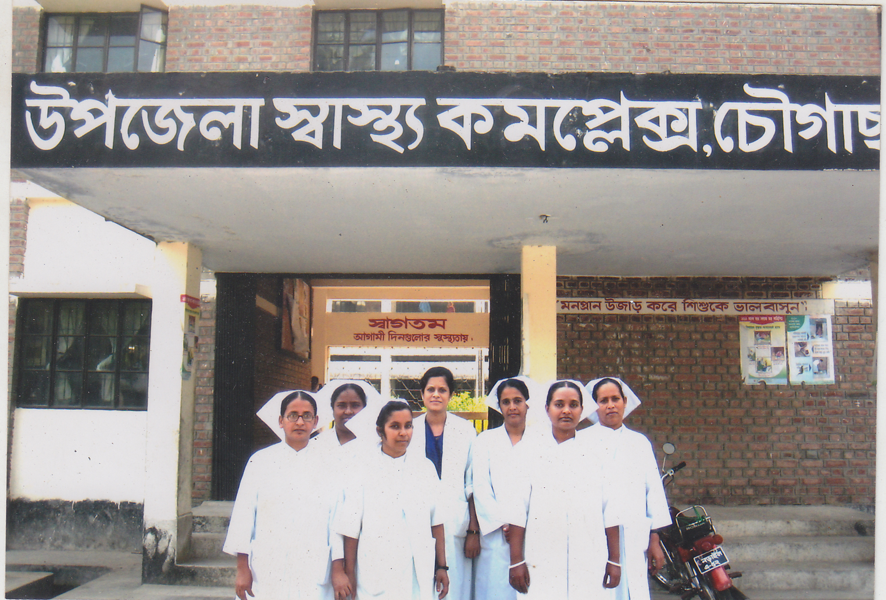
Dr. Salina and nurses who working in ANC corner & labour word.

Slide 9

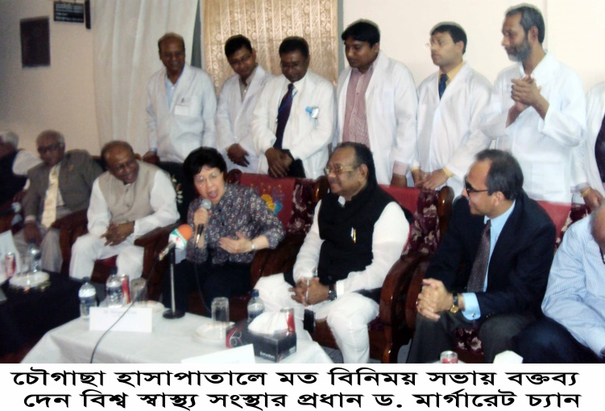
Òevsjv‡`‡ki Rb¨ ewnt we‡k¦i
†Kvb g‡W‡ji cÖ‡qvRb †bB|
†PŠMvQv g‡WjB h‡_ó ,
†PŠMvQv ¯^v¯’¨ †mevq `w¶Y
c~e© Gwkqv‡Z GKwU `„óvšÍ ¯’vcb K‡i‡Q|Ó
†PŠMvQv g‡Wj nvmcvZvj cwi`k©bKv‡j
W. gvM©v‡iU P¨vb (gnvcwiPvjK, wek¦ ¯^v¯’¨ ms¯’v)

Slide 10
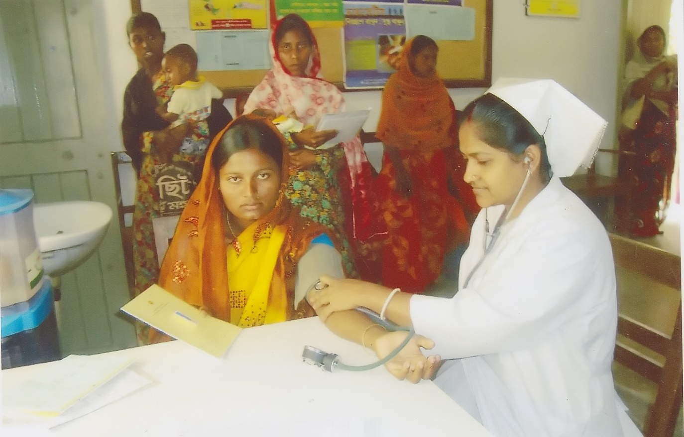
S.S.N working ANC corner

Slide 11
Introduction
Community engagement is the basic element to run a health institution efficiently and effectively.
Initiation of community engagement started in the year of 1996 in Chowgacha and 2012 in Jhenaidah
Sensitization of the service providers and community leaders on the basis of identified problem.
Inviting community how they can engage in the hospital management process.
Discussion initiated with the community for identification of areas.

Slide 12

Upazila Health Complex
CHOWGACHA , JESSORE.
EOC Activities : 1997- 2011 (Hospital Delivery )

Slide 13

Upazila Health Complex
CHOWGACHA , JESSORE.
EOC Activities : 2000 - 2011 (Caesarian Section)

Slide 14

Hon’ble Health Minister for Health & Family Welfare with WHO Representative at Chowgacha handing over money and gift of voucher scheme of DSF

Slide 15





Slide 16

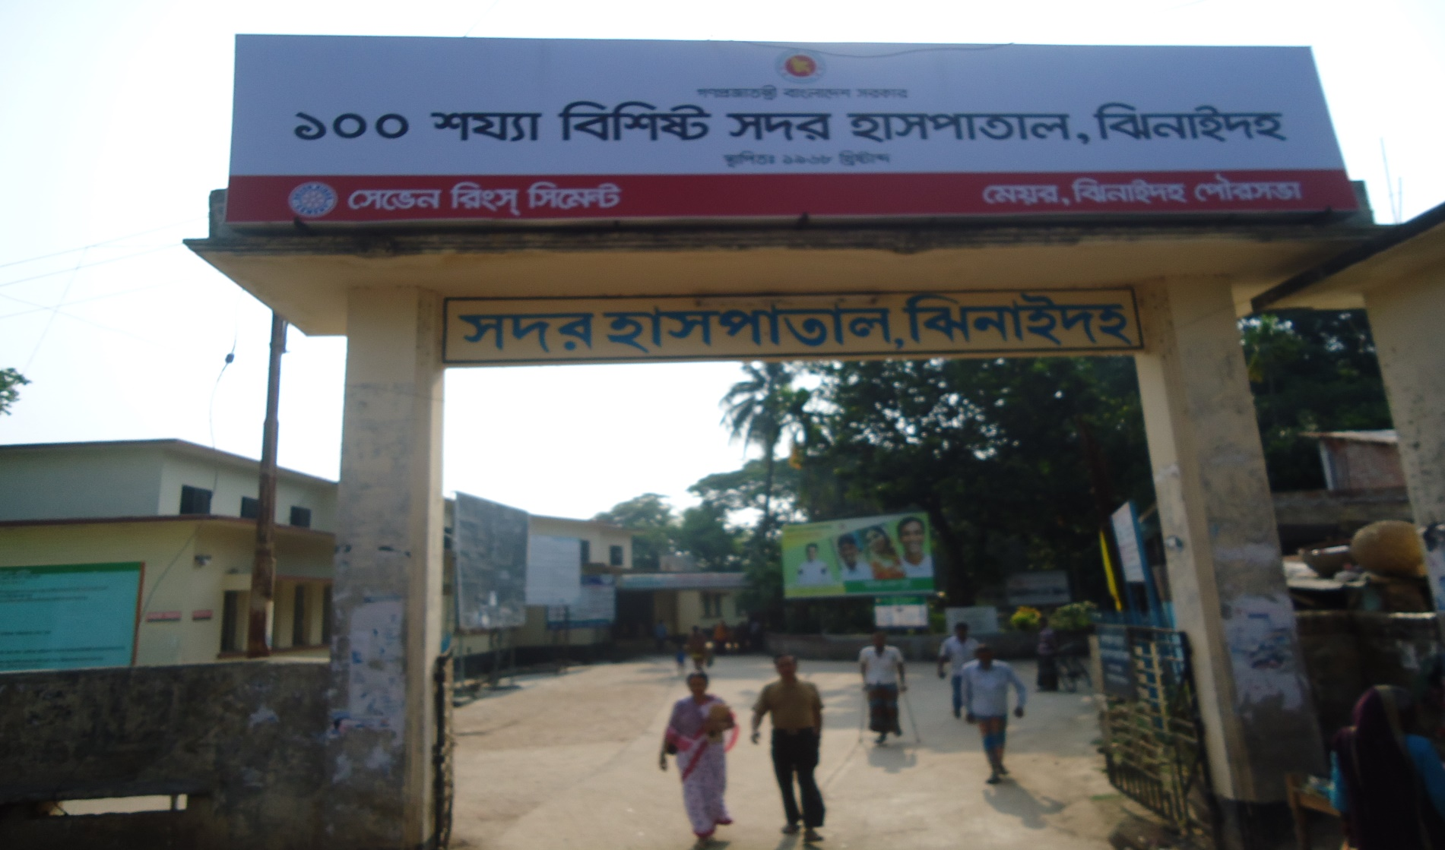
Community Participation in Jhenaidah Sadar Hospital
SADAR HOSPITAL, JHENAIDAH

Slide 17
Challenges before starting community participation !!
Limited human resources specially 4th class cleaner only (7).
No guard , gardener , ayah , ward boy , trolley man and electrician .
Inadequate all the services especially EOC and pediatric service.
Inadequate overall cleanliness.
Less coordination with local administration and community leaders .
Inadequate documentation and reporting System.
Insecure situation for the staff and hospital.
Hospital environment was not conducive .

Slide 18
Event of Community participant in Jhenaidah
Holding meeting with the service providers and hospital authority
Introduction of 5S KAIZEN in EOC ward
Baseline assessment
Dialogue with the local MP ,Mayor, local elites, Reporters and local administration
Forming “ Community Support group committee “ in Jhenaidah for improvement of district hospital.
Opening a bank account for the “ Community Support group “
Identification and sharing the type of support with the local community elite
Engagement of necessary support staff ( cleaners, Aya, ward boy, trolley man & security guards etc).
Holding monthly meeting with the local community support group.

Slide 19
Present support status !
54 manpower (Cleaner 19, Ayah & ward boy 20, Guard 7, Volunteer 5, Trolley man 3)
MP of Jhenaidah-2 himself providing support of 14 manpower .
Doctors of the hospital and Jhenaidah town supports 17 man power.
Mayor of Jhenaidah Paurasava plays an important role in cleanliness, repaired the boundary wall, supports 4 man power and renovation of pediatric word.
Retired secretary donated a generator for 24 hours OT service with a cost of nearly 33 thousand taka.
Chairman of Zahedee foundation supports 10 manpower and an intercom with a cost of nearly two lac taka.

Slide 20

Sadar Hospital, Jhenaidah
Bed Occupancy Rate from 1998 to 2015
Sl. No | Year | Bed Occupancy Rate
01 | 1998 | 126%
02 | 2011 | 146%
03 | 2013 | 165%
04 | 2015 | 193%

Slide 21
Emergency & Out Door, Indoor Service 1998 to 2015
Sadar Hospital, Jhenaidah

Slide 22
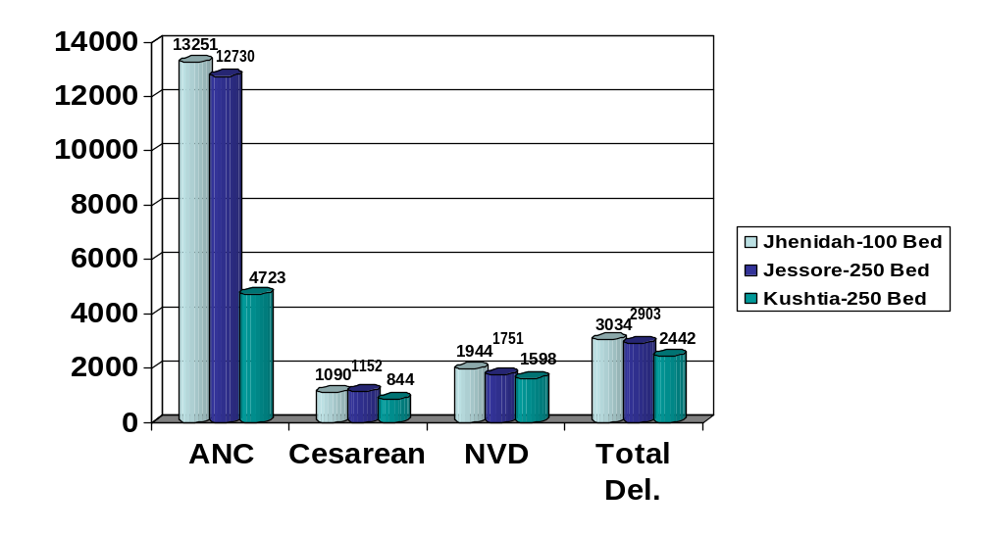
Comparative Data of EOC Service of 3 Best Performing District Hospital of Khulna Division in 2015

Slide 23
Operation Service (Major) 2011 to 2015
Sadar Hospital, Jhenaidah

Slide 24
Comparative data of revenue income in Jhenaidah Sadar Hospital from 2013-14 to 2015-16 F-year
Sadar Hospital, Jhenaidah

Slide 25


Introduction of TQM activities and Visit to Shatkhira District Hospital
  In 9 February, 2014, 5S-CQI -TQM program started by DGHS & SMPP JICA. Staff orientation on 5S-CQI-TQM process.
  5th August, 2014 an Idea sharing visit of 15 team members headed by civil surgeon at Shatkhira District Hospital with the help of JICA.

Slide 26


Display of citizens’ charter of Sadar Hospital.
Community supported guard is removing cycle, van and easy bike from the campus.

Slide 27


Cycle Stand
To secure the cycle and motor cycle of the patients and their attendants.
Safe drinking water supply for the patients and their attendants.

Slide 28


Hospital reception and information center for the patient and their attendance are developed by the community support system.
Display of the duty roaster of outdoor doctors.

Slide 29


Community supported trolley man is carrying a patient.
Community supported cleaner is cleaning the hospital.

Slide 30


To facilitate easier communication among the hospital staff an intercom is donated by an honorable local industrialist and thus the efficiency of the service has been improved
A non-operating government generator is activated and a new generator is supplied by the community to ensure electric facility.

Slide 31


Creation of awareness by Health Education for the patients and their attendances.
Motivation of the community, the teachers, reporters, social workers, cultural activists and donors of the hospital .

Slide 32


Antenatal and postnatal care of pregnant mother in antenatal corner of EOC word.
Breast feeding and family planning corner of EOC word.

Slide 33


Improved EOC (Emergency Obstetric Care) word service.
Improved pediatric word.

Slide 34


Girls’ Guide are working in the outdoor for lining of the patients to take proper service.
College going poor students are working in the hospital as nursing assistant (Volunteer).

Slide 35


Deputy Commissioner (DC), Jhenaidah visited the Sadar Hospital to observe the Hospital activities.
Superintendent of Police (SP), Jhenaidah visited the Sadar Hospital to observe the Hospital activities and to ensure security of the hospital.

Slide 36


MANOBOTA- a volunteer blood donor organization has formed by the doctors and SACMOs to donate blood for the thalasemic and other patient of the hospital.
A blood donation camp arranged by District Judge of Jhenaidah with the help of MANOBOTA.

Slide 37


Hospital campus beautification started by previous MP of Jhenaidah-2.
Beautification plant is planted by Zilla Praised Administrator and Upazilla Praised Chairman.

Slide 38


Hospital garbage is removed regularly by the Paurasava.
17th,March “a big cleaning day” is being celebrated to clean the hospital by DC, Mayor, Civil Surgeon & staffs of the hospital , under the leadership of Superintendent.

Slide 39
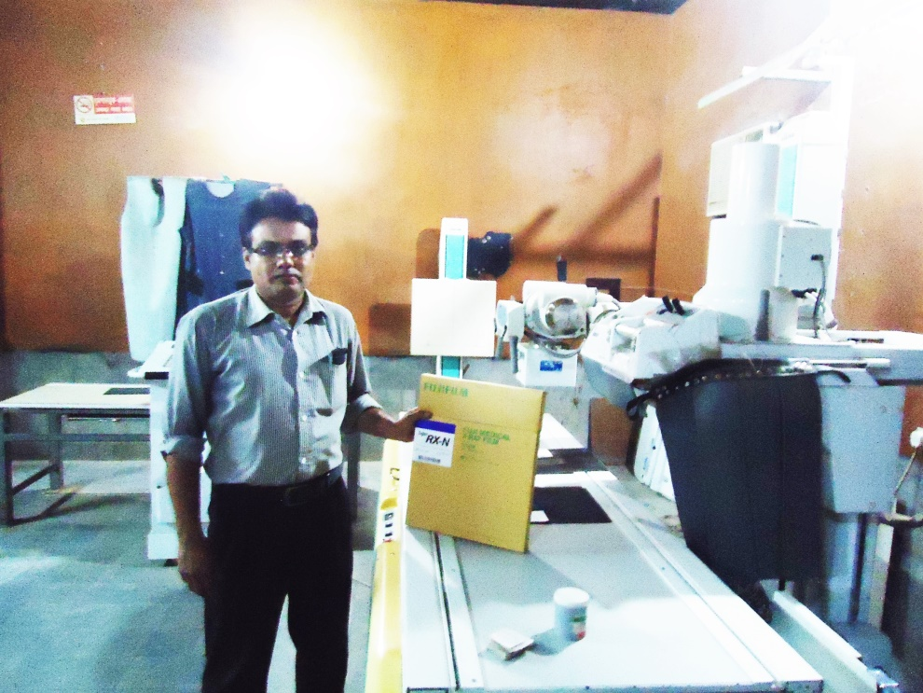
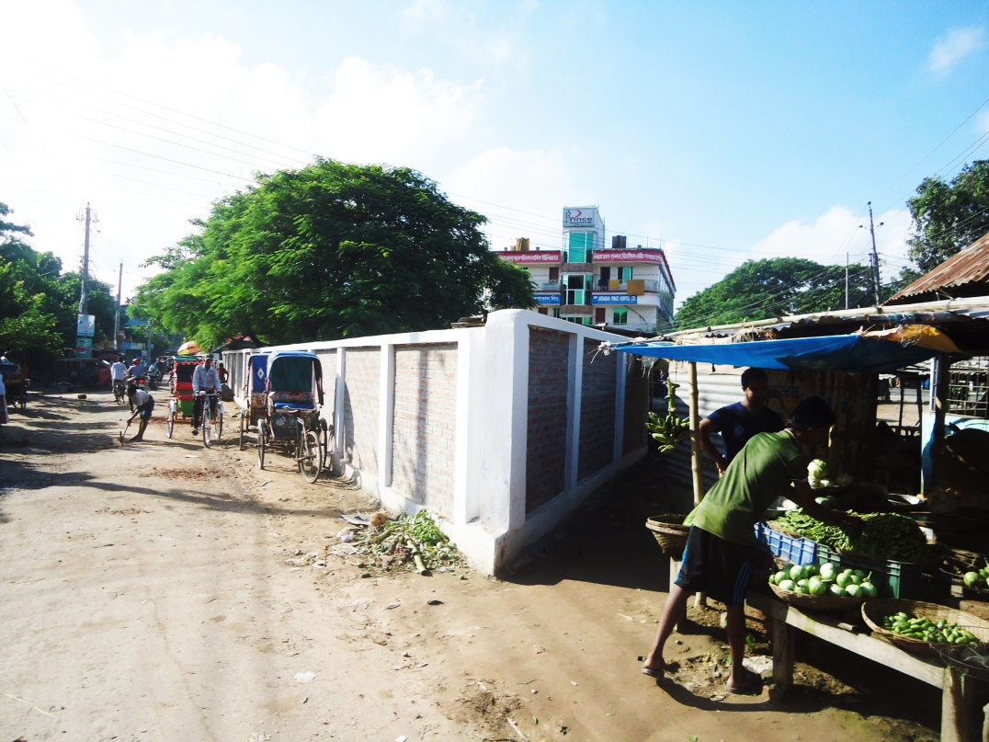
X-Ray Service system continued by the support of community in absence of supplying X-Ray film.
0.24 acre land of Jhenaidah Sadar Hospital has been saved from occupied with the support of Civil Surgeon, local administration, M.P. and Mayor.

Slide 40


Meeting of the stakeholders with the stakeholders and donors of Jhenaidah Sadar Hospital with additional secretary (health) Md. Asadul Islam.
Meeting of QIT (Quality Improvement Team) is held in the conference of Jhenaidah Sadar Hospital.

Slide 41




Changes in EOC Ward
Before
After
Before
After
Before
After

Slide 42








Changes in Surgery Ward

Slide 43




Changes in Padietric & Medicine Ward
Before
After
Before
After

Slide 44




West Management & Campus Protection
Before
After
Before
After

Slide 45





Changes in Gardens of The Hospital
Before
After
Before
After

Slide 46




Changes in office and hospital internal environment
Before
After
Before
After

Slide 47




Internal Monitoring System
Meting of health improvement committee
Meting of community support group committee
Monthly meeting schedule
QIC meeting

Slide 48




Use of direction sign, labeling of rooms, clean latrine and waist segregation
Use of direction sign
Labeling of rooms
waist segregation
Clean latrine

Slide 49



Improved pediatric word by local initiative

Slide 50




Hospital Environment

Slide 51
Jhenaidah Sadar Hospital, Jhenaidah
Achievement of the Hospital
1. Active Community Participation established for the hospital service improvement .
2. Improved performance of all services specially pediatric, obstetric and operation.
3. Improved cleanliness and beautification of the hospital.
4. Functioning of X-Ray service by local initiatives.
5. Improved security.
6. Improved financial management
7. The hospital is awarded 4 times from 2013 to 2016.

Slide 52
Way forward
Involvement of community for hospital service improvement
Leadership of health manager
Motivation of the service providers
Ownership of the community support group.
Support from the local administration.

Slide 53


